Slide 1
“Prioritizing and Unpacking the Standards”
Presented by Jill Hale and Alison Frye
Granite School District
Valley Crest Elementary School
October 28, 2016

Slide 2
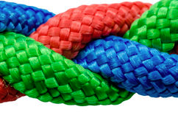
The Way
Fidelity to the Core
Instructional Framework
District Tools & Assessments
Professional Learning Communities
Multi-Tiered Systems of Support

Slide 3
Today’s Objectives
To give you time to figure out what math standards to focus on, what they mean and what impact they need to have on your teaching and on……
Student Learning
Notes:
We will be demonstrating one method for the development of CFAs, but there may be other resources that you can utilize. Some of your faculty will be demonstrating how to access material on the SAGE format.

Slide 4
Today’s Agenda
8:30-8:35 – Welcome
8:35-9:20 – Prioritizing Math Standards
9:20-9:45- Mapping
Happy Halloween!
9:45-10:00 Break
10:00-10:45- Unpacking Math Standards
10:45-11:20-Assessing Student Learning
11:20-11:30-Wrap-up
Notes:
Point out that today is their day. We designed the agenda so that the majority of time will be spending on prioritizing and unpacking standards with your teams. Once they are developed you will be able to utilize them next year as well. Review the agenda.

Slide 5
Use Data to Examine Effectiveness of Instructional Practices
Identify Essential Core Standard(s)
Determine what students need to know and be able to do for mastery
Reteach, Support, Enrich
The PLC Cycle
Determine Prerequisite
Knowledge
Administer & Analyze Common Formative Assessment
Design Common Formative Assessment based on Standard
Teach
Check for understanding
Plan Differentiated Instruction
Notes:
State the purpose of a PLC. Highlight CFA sections. Tie into their PLC experience. Talk about collaboration and the problem solving model. The model is focused on teacher decision making. You decide what types of assessments to give, the criteria to grade the CFAs, and the next instructional steps based on the results of the assessments.

Slide 6
Learning Task
Identify Essential Standards
Individually circle/mark the math standards you believe are
the most vital for students to master by the end of the year.
Guiding Questions:
What do my students need for success in life?
What do my students need for success in school?
What do my students need for success on the state test or other appropriate assessments?
Refer to your Granite Benchmark results-Math pre-semester 1
Notes:
10 minutes (about 1/3 of the standards)

Slide 7
Learning Task
Consensus
Talk to your team and discuss which standards each person chose. Come to consensus on which standards are most important. The goal is to reach an initial consensus.
Guiding Questions:
What do my students need for success in life?
What do my students need for success in school?
What do my students need for success on the state test or other appropriate assessments?
Refer to your Granite Benchmark results-Math pre-semester 1
Notes:
30 minutes

Slide 8
Mapping Your Essential Standards

Slide 9
Learning Task
Mapping
Use the GSD Math Curriculum Map Scope and Sequence
Highlight your priority standards
Draw a line indicating where you are currently at in your teaching.
Draw a line where you should be by the end of the semester to be prepared for benchmarks.
Use the Pacing Map to help you determine where each quarter ends

Slide 10
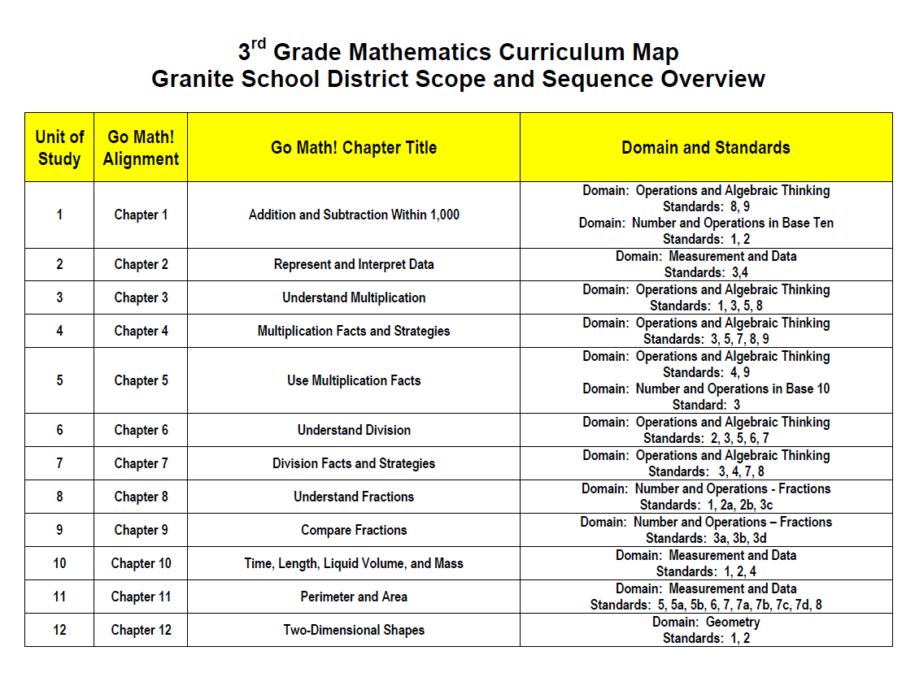
Notes:
Have the teachers draw a line indicating where they are currently at in their teaching. Draw a line where they should be by the end of the semester to be prepared for benchmarks. Highlight standards your grade level has identified.

Slide 11
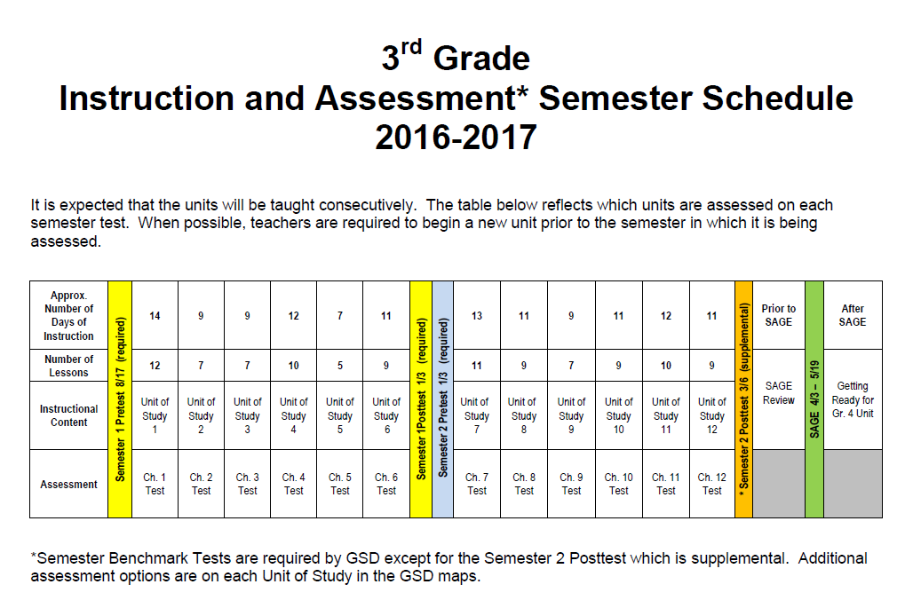
GSD MATH PACING MAP
Notes:
Tell how to access on website (handout)
Using the Pacing Map, determine what unit you are on. We recommend looking at units in advance to give you plenty of time to complete the process of identifying priority standards and developing your CFAs.

Slide 12
Mapping Example
Notes:
Only fill out where your priority standards fall (in which quarter) there is a school year map on the back., the unit, and the Pre benchmark score from the Standards analysis report from School City. You will fill out your instruction and formative assessments dates as you meet through the year K eep this document with your PLC materials that you use in collaboration.

Slide 13
Granite Benchmark Standards’ Report

Slide 14
Learning Task
Mapping Continued
Map out your identified standards on the Quarterly Template, include:
Math standards
Go Math! Unit
Pre Math Benchmark results
Fill in the timeline as you meet through the year

Slide 15
15 minutes

Slide 16
Unpacking Your Essential Standards

Slide 17
Why Unpack the Standards?
“You see, I'm really kind of worried that we will spend our time in committees and groups of teachers analyzing the standards for other people when the real learning for teachers comes from doing it for myself…- asking MYSELF what I know, what I need to know, what my students know and what they need to know - - it's about tailoring our work with the Common Core to MY students and YOUR students.” Jill Jackson

Slide 18
IDENTIFIED ESSENTIAL STANDARD
3.NF.3b Recognize and generate simple equivalent fractions, e. g. 1/2=2/4, 4/6=2/3. Explain why the fractions are equivalent, e.g. by using a visual fraction model.
Notes:
Here is an example of an identified priority standard. The red identifies what students need to be able to DO, and the underlined identifies what students need to KNOW.
Notice depth of knowledge or complexity of the standard.
The Depth of Knowledge is NOT determined by the just the verb but by the context in which the verb is used and the depth of thinking required.
***Even within this standard there are several DOKs.

Slide 19
Depth of Knowledge (DOK)
Level 1: Recall and Reproduction
Determine the perimeter or area of rectangles given a drawing or labels
Level 2: Skills & Concepts
Classify plane and three dimensional figures
Level 3: Strategic Thinking
Solve a multiple-step problem and provide support with a mathematical explanation that justifies the answer
Level 4: Extended Thinking
Gather, analyze, organize, and interpret information from multiple (print and non print) sources to draft a reasoned report
Notes:
Scale is divided in 4 levels

Slide 20
Why is it important to identify DOK?
To better understand the what students need to know and do to be proficient in each standard.
To help teachers differentiate instruction
To assist teachers in choosing questions for CFAs that align with the standards
To better prepare students for SAGE because questions are categorized by DOK levels
To identify which Surface Learning or basic skills and knowledge need to be in place before Deep Learning or complex thinking can be accomplished

Slide 21
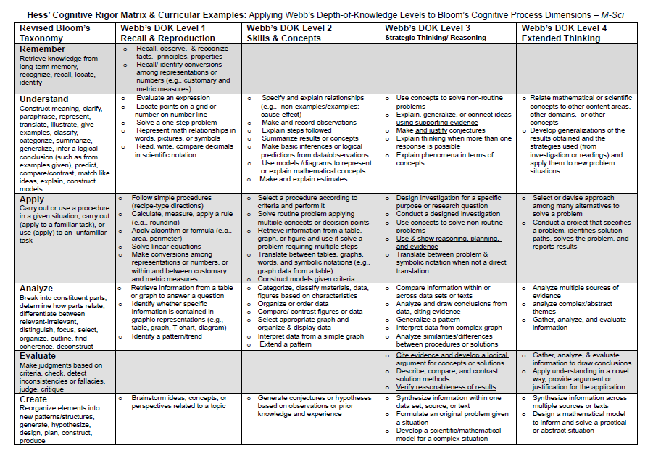

Slide 22
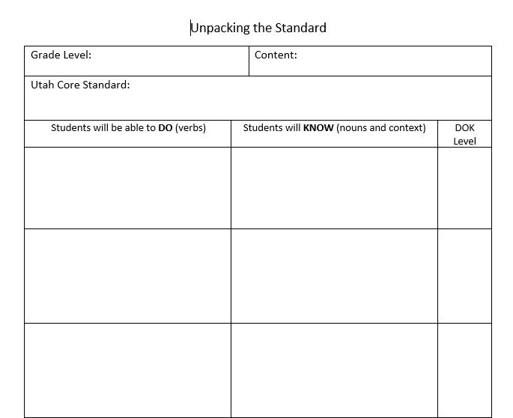
Notes:
Go to word document-Walk through standard 3.NF.3b

Slide 23
Learning Task
Unpacking the Standards
Choose a standard that will be taught in the next few weeks.
Highlight what students need to “do”
Underline what students need to “know”
Fill in the provided template
Identify the DOK using the Rigor Matrix as a reference
Notes:
45 minutes-Move on to another standard if you finish

Slide 24
Assessing Student Learning

Slide 25
Use Data to Examine Effectiveness of Instructional Practices
Identify Essential Core Standard(s)
Determine what students need to know and be able to do for mastery
Reteach, Support, Enrich
The PLC Cycle
Determine Prerequisite
Knowledge
Administer & Analyze Common Formative Assessment
Design Common Formative Assessment based on Standard
Teach
Check for understanding
Plan Differentiated Instruction
Notes:
State the purpose of a PLC. Highlight CFA sections. Tie into their PLC experience. Talk about collaboration and the problem solving model. The model is focused on teacher decision making. You decide what types of assessments to give, the criteria to grade the CFAs, and the next instructional steps based on the results of the assessments.

Slide 26
Common Formative Assessments-Definition
Collaboratively created or agreed upon
Assess all students with the same rigor, on the same targets
Focus on student learning
Collaboratively analyzed results
Modify instruction based on student needs
Used to provide “real time” intervention and extension
The Leadership and Learning Center
Notes:
How often? How many?....only give CFAs as often as you are willing to make instructional adjustments. Steve Ventura
Items are collaboratively designed by participating teachers.
Mini benchmarks

Slide 27
Resources for CFA questions
Mid-chapter/Chapter tests
Teacher Created
School City item bank
Go Math!
Notes:
Some of your colleagues are going to share how to get to the SAGE Question bank.
Refer to CFA examples

Slide 28
Example CFA created in School City

Slide 29
Learning Task
Create a CFA
Select an unpacked priority standard
Find questions that will assess student learning at the determined DOK levels.
Determine how you will score it, when you will give it and when you will analyze the results.
Notes:
35 minutes

Slide 30
Next Steps
Teachers can use the results of CFAs to:
Diagnose student learning difficulties
Set individual teacher goals for student improvement
Set team goals for student improvement
Identify and share effective instructional strategies
Plan differentiated instruction
Aimsworth and Viegut, 2006

